Slide 1
Varni na internetu
Elijah Hlastan
Notes:
we all use technology nowadays. its in every aspect of our life weather we like it or not. its in our cars, our houses, watches and so on.
with all the technology around us it can be easy to fall victum to a scam or fraud. there are thousands of phishing emails floating around just waiting for someone to open their attatchment.
thousands of malicious actors out there just waiting for us to log in to a lookalike site. and thousands of ways for them to trick us.

Slide 2
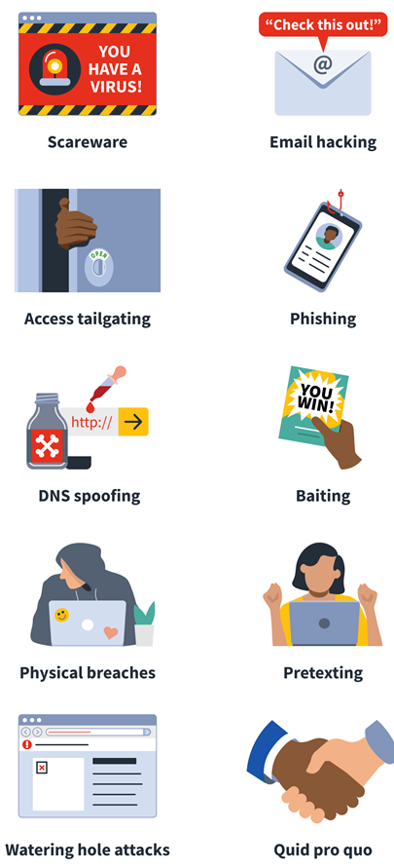
Kaj je socialni inženiring?
Socialni inženiring je med prevaranti najpogosteje uporabljena tehnika za pridobivanje in zlorabo osebnih podatkov.
Napadalec od žrtve pridobi zaupne podatke in informacije s pomočjo zlorabe zaupanja.
Notes:
today I would like to talk about this topic. specifically social engineering and how it can affect schools.
when I was in school one of my worst fears was having a bad grade. this and my family finding out about it. in my case that fear was never acted upon but for some others they can turn to malicious acts to cover up one bad grade
with schools shifting to the use of electronic grading its easier than ever for a student to obtain access to their teachers grading system and manually fix their grades. some may even do it for proffit.
but whereas it used to be a student had to gain physical access to a teachers computer or grade book. now it can be done remotely. all the students need are a bit of social engineering.

Slide 3
Najpogostejše oblike napadov
Notes:
there are many types of social engineering that people use to exploit a persons trust and lower their guard. the most common are using phishing emails
a user can claim to be anyone online and this goes for emails as well. its not hard to find information about people and their emails, create a fake email and send someone a legitimate looking email.
a good example is this email from NLB which asked users to fill out the form. now this email was part of a sophisticated malware spreading campagne it doesnt take much knowledge to pull this off...
with just a very simple call to action and a legitimate looking sender and website a malicious actor can harvest thousands of credentials without much effort. an example is this amazon login page used in 2017.

Slide 4
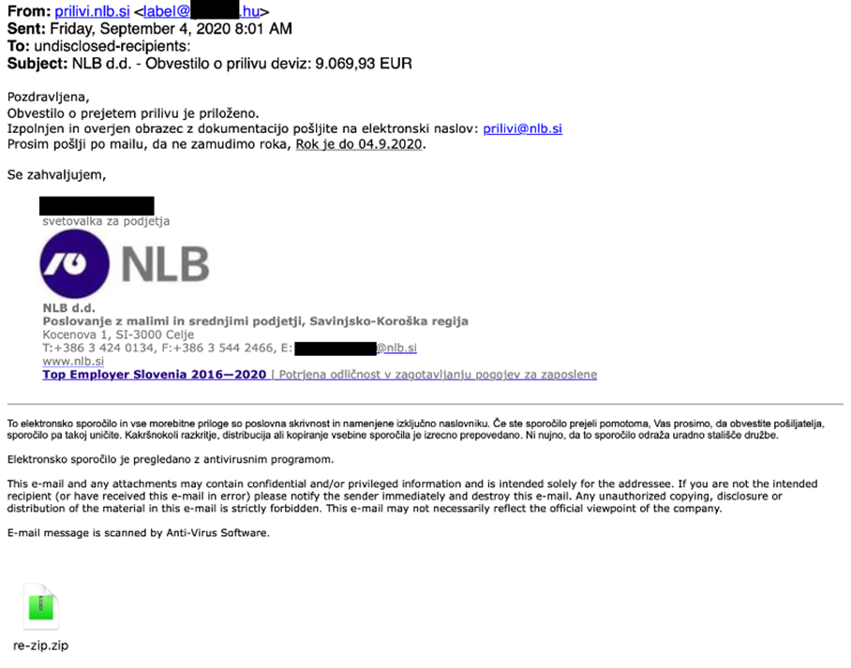
Ribarjenje
Nigerijska prevara
Romanca
Banka
Notes:
these are simple types of attacks used daily all around the world and they are ever evolving so it isnt a good idea to memorise the attack but to learn how to look for inconsistencies or "red flags" and be able to judge for yourself
with all of these previous attacks we can easily spot some major flaws that can turn these scams upside down.
the NLB email. if we look closely at it we can see the sender is a user with a hungarian email address.... why is NLB sendimg emails from hungary?

Slide 5
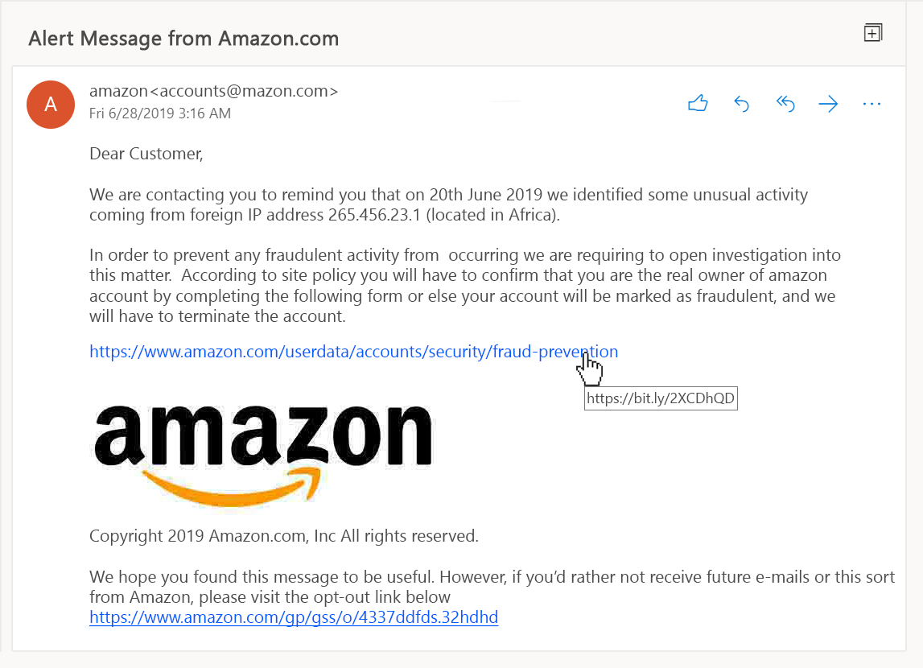

Slide 6
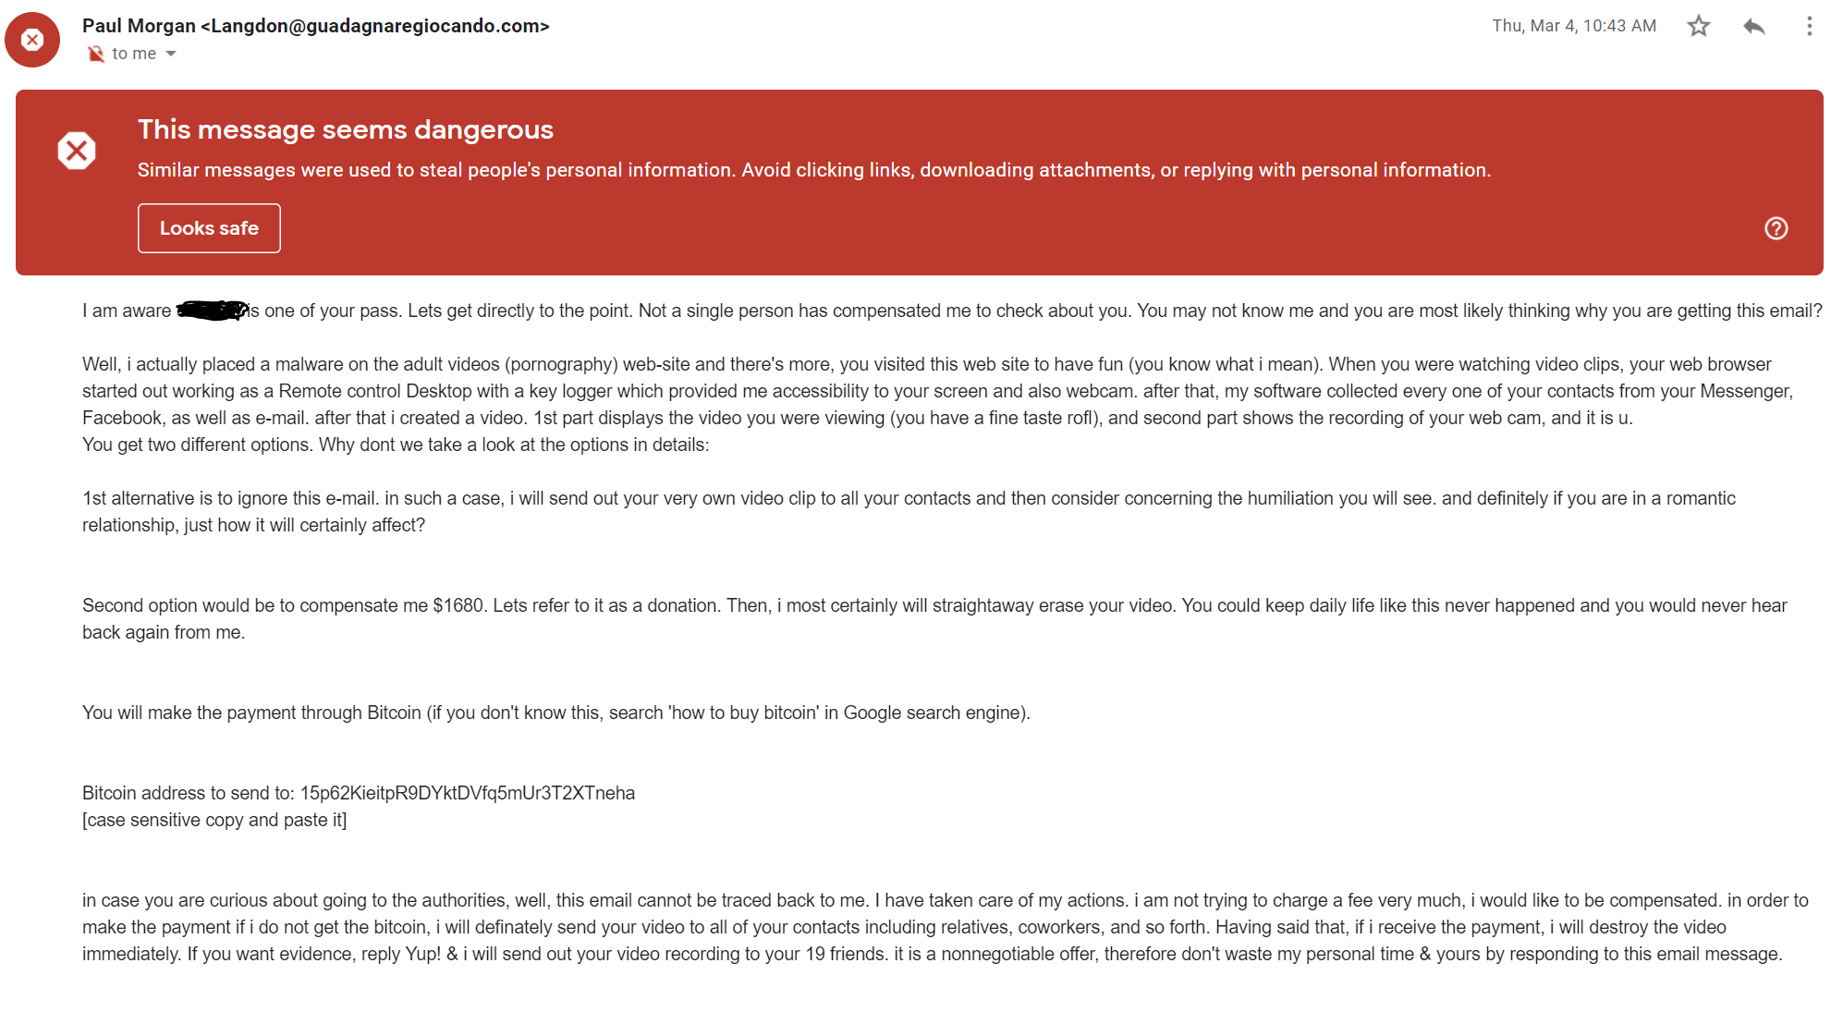

Slide 7
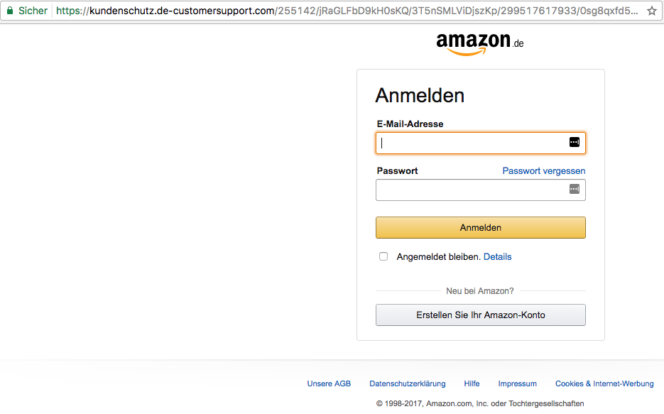
Spletne prevare
Url naslov
Tipkarske napake
„predobro da bi bilo res“

Slide 8
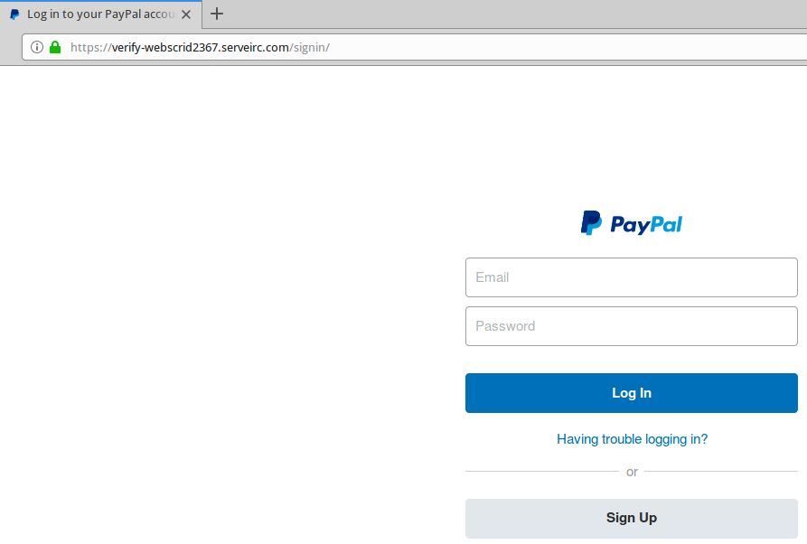

Slide 9
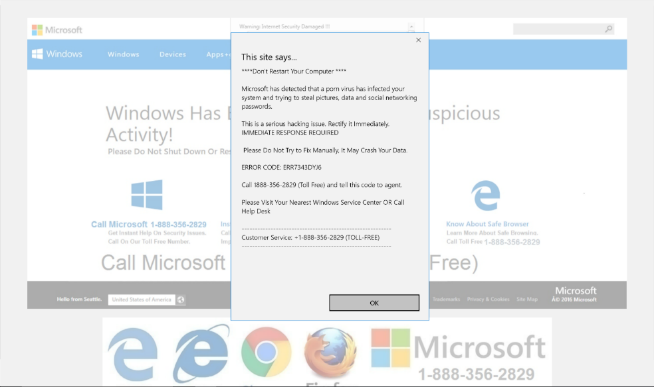

Slide 10
Telefonske prevare
Microsoft tech support
IRS (FURS)
Notes:
these are some very large red flags that if spotted in time can make a huge difference. but these are just emails and websites. a few methods that are a bit less common but very effective are calling.
give example of me in highschool with deutcshbauer.

Slide 11
Gesla
123456
123456789
qwerty
password
111111
12345678
abc123
1234567
password1
12345
Multifaktorska avtentikacija
Enaka gesla na različnih straneh
Notes:
all of the mentioned examples require some technical knowledge and trickery to get access... but often people make passwords easily rememberable or even write it down on paper allowing attackers to guess the password or read it.
also in cases like that people dont use additional methods of securing their accounts like 2FA or backup codes which makes the attackers work easier.

Slide 12
Primeri dobre prakse
2x preverimo pošiljatelja
Preverimo vsebino
Posredujemo osebi, katera je zadolžena za varnost v podjetju
Redna menjava gesla
Morebiten preklic certifikata
Zaklepanje službenih naprav zapustitvi delovnega mesta
Uporaba MFA/2FA
Bolje biti preveč previden kot premalo
Notes:
but enough of the attacks... what can we do to prevent this?
lets start simple. the easiest ways to secure accounts are to enable any missing security mechanism not enabled like 2FA and also good pasword higene. change your passwords often and dont reuse them.
the passwords you use dont save on sticky notes or write them in a word document. securely save them if its too hard to remember.
lock your computers before leaving your desk and dont leave them unlocked unatended.

Slide 13
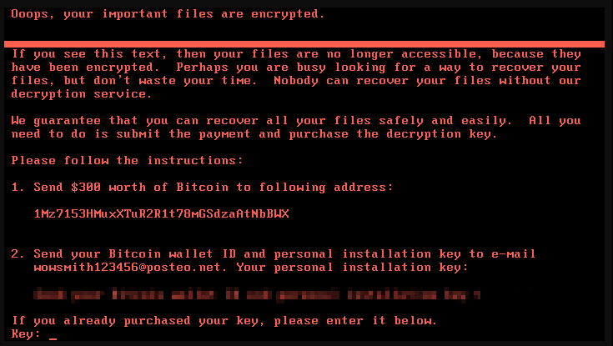
Notes:
learn the red flags of phishing scams and practice good higene of "not replying" to suspiciois looking emails. warn others of obvius or even potential scams, emails or phischign sites and calls....
if you fall victim of an attack then dont feel afraid to ask for help. we are human and we all mess up.
if you are in fact a victum of an attack then contacting the proper people or authorities can help in saving data, money or in some cases jobs.
if you know of someone who has falen victim then there needs to be a proper response. learn your companies response policy and use it.

Slide 14
Hvala za pozornost
Elijahbenjamin.hlastan@astec.si

